Slide 1



LAB 4:
RECURRENT NEURAL NETWORKS
(RNNs)
University of Washington, Seattle
Spring 2025

Slide 2
OUTLINE
Part 1: Introduction to RNNs
Why do we need RNNs?
RNN Architecture
RNN in PyTorch
Embedding and Decoder
Part 2: Training RNNs
Backpropagation in RNNs
Vanishing/Exploding Gradient Problem
Training with Teacher Forcing
Part 3: Gated RNNs
LSTM and GRU
Part 4: RNN Problem Types
RNN Configurations
Part 5: RNN Implementation in PyTorch
Character Level Generation Shakespeare Dataset
Lab Assignment
Create Arthur Conan Doyle AI

Slide 3
INTRODUCTION TO RNNs Why do we need RNNs? RNN Architecture RNN in PyTorch Embedding and Decoder

Slide 4
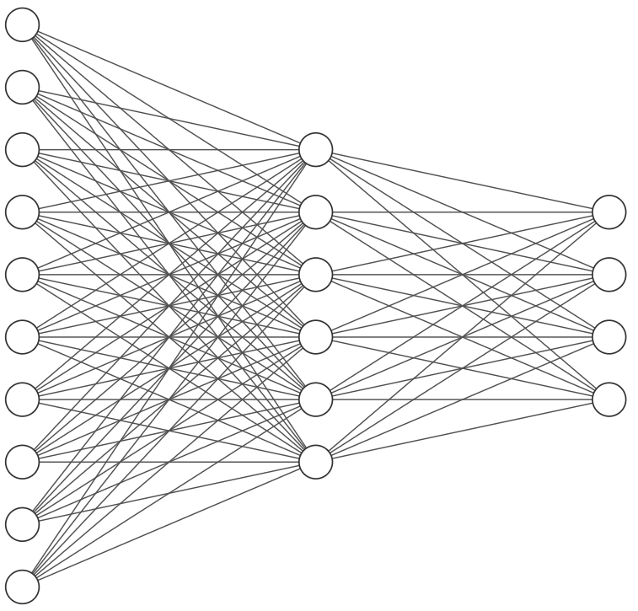

Why Do We Need RNNs?
0
0
0
0
0
1
0
0
0
0
5!
Flatten
. . .
. . .
Input
Output
. . .
Feed-Forward Network
Notes:
In this course, we will be using PyTorch as our main deep learning framework

Slide 5
Why Do We Need RNNs?
Wait, what did I just process?
0
0
0
0
0
1
0
0
0
0
. . .
. . .
Input
Output
. . .
Feed-Forward Network
Notes:
In this course, we will be using PyTorch as our main deep learning framework

Slide 6
Why Do We Need RNNs?
Wait, what did I just process?
0
0
0
0
0
1
0
0
0
0
. . .
. . .
Input
Output
. . .
Feed-Forward Network has no memory of past inputs
Notes:
In this course, we will be using PyTorch as our main deep learning framework

Slide 7
Why Do We Need RNNs?
Korean
안녕하세요, 제 이름은 지민이에요
English
Hello, my name is Jimin
Notes:
In this course, we will be using PyTorch as our main deep learning framework

Slide 8
Why Do We Need RNNs?
Korean
안녕하세요,
English
Hello,
Notes:
In this course, we will be using PyTorch as our main deep learning framework

Slide 9
Why Do We Need RNNs?
Korean
안녕하세요, 제
English
Hello, my
Notes:
In this course, we will be using PyTorch as our main deep learning framework

Slide 10
Why Do We Need RNNs?
Korean
안녕하세요, 제 이름
English
Hello, my name
Notes:
In this course, we will be using PyTorch as our main deep learning framework

Slide 11
Why Do We Need RNNs?
Korean
안녕하세요, 제 이름은
English
Hello, my name is
Notes:
In this course, we will be using PyTorch as our main deep learning framework

Slide 12
Why Do We Need RNNs?
Korean
안녕하세요, 제 이름은 지민이에요
English
Hello, my name is Jimin
Notes:
In this course, we will be using PyTorch as our main deep learning framework

Slide 13
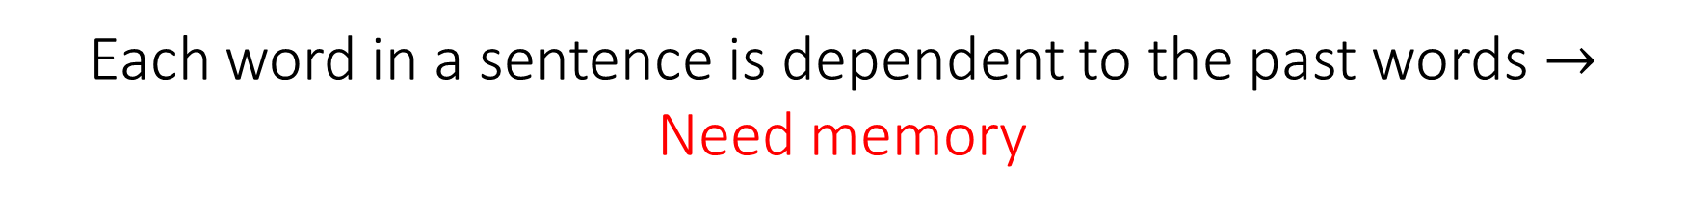
Why Do We Need RNNs?
Korean
안녕하세요, 제 이름은 지민이에요
English
Hello, my name is Jimin
Each word in a sentence is dependent to the past words $→$
Need memory
Notes:
In this course, we will be using PyTorch as our main deep learning framework

Slide 14
Why Do We Need RNNs?
Korean
안녕하세요, 제 이름은 지민이에요, 그리고 저는 비디오게임을 좋아해요
English
Hello, my name is Jimin, and I like videogames
A sentence (input) could have different sizes
Notes:
In this course, we will be using PyTorch as our main deep learning framework

Slide 15
Why Do We Need RNNs?
We need a neural network architecture that can handle:
Notes:
In this course, we will be using PyTorch as our main deep learning framework

Slide 16
Why Do We Need RNNs?
We need a neural network architecture that can handle:
Data order
Notes:
In this course, we will be using PyTorch as our main deep learning framework

Slide 17
Why Do We Need RNNs?
We need a neural network architecture that can handle:
Data order
Temporal dependencies
Notes:
In this course, we will be using PyTorch as our main deep learning framework

Slide 18
Why Do We Need RNNs?
We need a neural network architecture that can handle:
Data order
Temporal dependencies
Variable input sizes
Notes:
In this course, we will be using PyTorch as our main deep learning framework

Slide 19
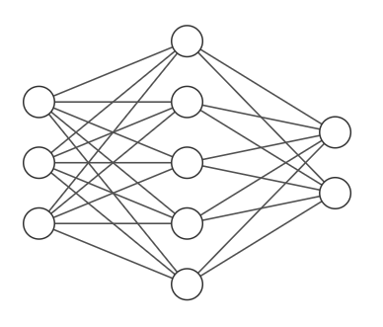
Why Do We Need RNNs?
We need a neural network architecture that can handle:
Data order
Temporal dependencies
Variable input sizes
Output
Recurrent Neural Network
Hidden
Input
Notes:
In this course, we will be using PyTorch as our main deep learning framework

Slide 20

RNN Architecture
Output
Hidden
Input
Unfold in Time
Notes:
In this course, we will be using PyTorch as our main deep learning framework

Slide 21
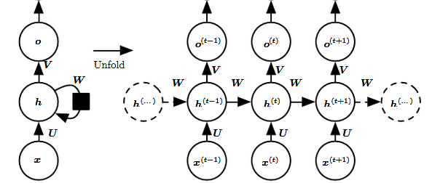
RNN Architecture
Output
Hidden
Input
Unfold in Time
Notes:
In this course, we will be using PyTorch as our main deep learning framework

Slide 22
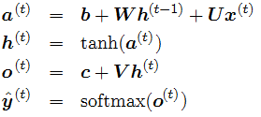
RNN Architecture
Output
Hidden
Unfold in Time
Input
Notes:
In this course, we will be using PyTorch as our main deep learning framework

Slide 23
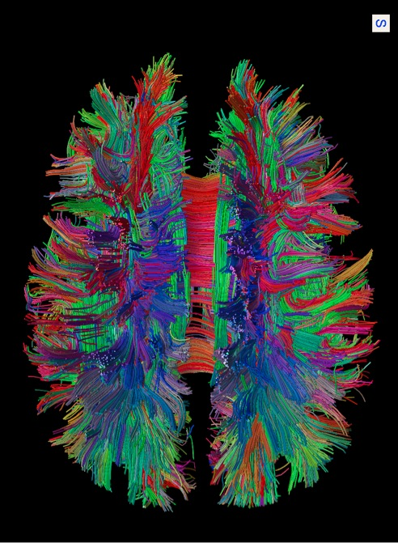
Neurons themselves have continuous voltage dynamics Different parts of brain exchange information both forward and backward
Brain is Highly Recurrent
Notes:
In this course, we will be using PyTorch as our main deep learning framework

Slide 24
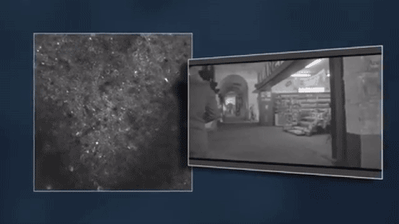
Brain is Highly Recurrent
Notes:
In this course, we will be using PyTorch as our main deep learning framework

Slide 25
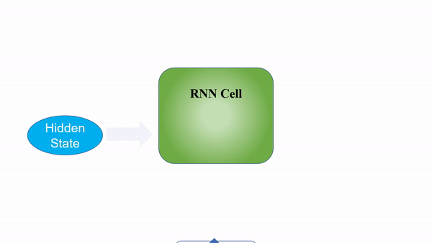
RNN Architecture
Notes:
In this course, we will be using PyTorch as our main deep learning framework

Slide 26
RNN Architecture
output
안녕하세요
hidden
input
Hello
Notes:
In this course, we will be using PyTorch as our main deep learning framework

Slide 27
RNN Architecture
output
안녕하세요
제
hidden
input
Hello
my
Notes:
In this course, we will be using PyTorch as our main deep learning framework

Slide 28
RNN Architecture
output
안녕하세요
제
이름
hidden
input
Hello
my
name
Notes:
In this course, we will be using PyTorch as our main deep learning framework

Slide 29
RNN Architecture
output
안녕하세요
제
이름
은
hidden
input
Hello
my
name
is
Notes:
In this course, we will be using PyTorch as our main deep learning framework

Slide 30
RNN Architecture
output
안녕하세요
제
이름
은
지민이에요
hidden
input
Hello
my
name
is
Jimin
Notes:
In this course, we will be using PyTorch as our main deep learning framework

Slide 31
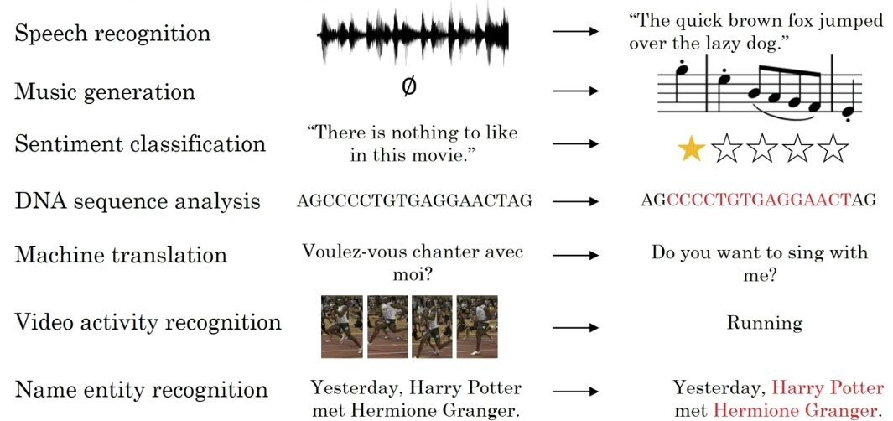
Sequential Data
Notes:
In this course, we will be using PyTorch as our main deep learning framework

Slide 32
RNN in PyTorch
torch.nn.RNN(
input_size
hidden_size
num_layers
Nonlinearity
)
Parameter description
# of expected features in the input
# of features in the hidden state
# of recurrent layers
Non-linearity to use
Data type
int
int
Default = 1
int or tuple (default = ‘tanh’)
Official documentation: https://pytorch.org/docs/stable/generated/torch.nn.RNN.html
Notes:
In this course, we will be using PyTorch as our main deep learning framework

Slide 33
Embedding and Decoder
안녕하세요
output
안녕하세요
Decoder
hidden
input
Hello
Embedding
Hello
Notes:
In this course, we will be using PyTorch as our main deep learning framework

Slide 34
Embedding
안녕하세요
Embedding dim
8 | 2 | 1 | 9
6 | 5 | 4 | 0
7 | 1 | 6 | 2
1 | 3 | 5 | 8
0 | 4 | 9 | 1
Hello
4
# of Embeddings
Input
Number representation
Embedding Matrix
Hello
Notes:
In this course, we will be using PyTorch as our main deep learning framework

Slide 35
Embedding
제
8 | 2 | 1 | 9
6 | 5 | 4 | 0
7 | 1 | 6 | 2
1 | 3 | 5 | 8
0 | 4 | 9 | 1
My
2
Input
Number representation
Embedding Matrix
My
Notes:
In this course, we will be using PyTorch as our main deep learning framework

Slide 36
Embedding
제
8 | 2 | 1 | 9
6 | 5 | 4 | 0
7 | 1 | 6 | 2
1 | 3 | 5 | 8
0 | 4 | 9 | 1
My
2
Input
Number representation
Embedding Matrix
My
Embedding matrix is trainable
Notes:
In this course, we will be using PyTorch as our main deep learning framework

Slide 37
Embedding
제
8 | 2 | 1 | 9
6 | 5 | 4 | 0
7 | 1 | 6 | 2
1 | 3 | 5 | 8
0 | 4 | 9 | 1
My
2
Input
Number representation
Embedding Matrix
My
torch.nn.embedding(num_embeddings, embedding dim)
https://pytorch.org/docs/stable/generated/torch.nn.Embedding.html
Notes:
In this course, we will be using PyTorch as our main deep learning framework

Slide 38
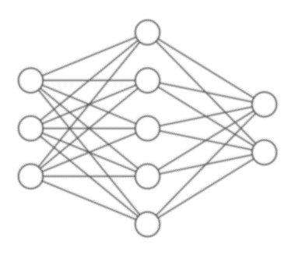
Decoder
안녕하세요
Output
안녕하세요
p(4)
Number representation
(softmax)
Decoder Network
Hidden state
Hello
Notes:
In this course, we will be using PyTorch as our main deep learning framework

Slide 39
Decoder
안녕하세요
Output
안녕하세요
p(7)
Number representation
(softmax)
Decoder Network
Hidden state
Hello
torch.nn.Linear(hidden_size, output_size)
Notes:
In this course, we will be using PyTorch as our main deep learning framework

Slide 40
TRAINING RNNs Backpropagation in RNNs Vanishing/Exploding Gradient Problems Training RNNs with Teacher Forcing

Slide 41

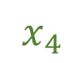
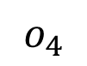
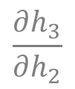

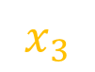
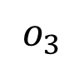
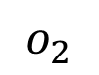
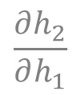

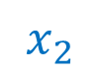

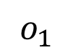
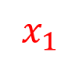
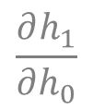

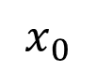
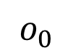
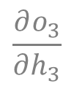
Backpropagation in RNNs
Forward
Backward
output
$$o_{0}$$
$$o_{1}$$
$$o_{2}$$
$$o_{3}$$
$$o_{4}$$
$$\frac{∂h_{1}}{∂h_{0}}$$
$$\frac{∂h_{2}}{∂h_{1}}$$
$$\frac{∂h_{3}}{∂h_{2}}$$
$$\frac{∂o_{3}}{∂h_{3}}$$
hidden
$$h_{0}$$
$$h_{1}$$
$$h_{2}$$
$$h_{3}$$
$$h_{4}$$
input
$$x_{0}$$
$$x_{1}$$
$$x_{2}$$
$$x_{3}$$
$$x_{4}$$
Notes:
In this course, we will be using PyTorch as our main deep learning framework

Slide 42
Backpropagation in RNNs
Forward
Backward
output
$$o_{0}$$
$$o_{1}$$
$$o_{2}$$
$$o_{3}$$
$$o_{4}$$
$$\frac{∂h_{1}}{∂h_{0}}$$
$$\frac{∂h_{2}}{∂h_{1}}$$
$$\frac{∂h_{3}}{∂h_{2}}$$
$$\frac{∂o_{3}}{∂h_{3}}$$
hidden
$$h_{0}$$
$$h_{1}$$
$$h_{2}$$
$$h_{3}$$
$$h_{4}$$
input
$$x_{0}$$
$$x_{1}$$
$$x_{2}$$
$$x_{3}$$
$$x_{4}$$
Backpropagation is performed backward in time
Notes:
In this course, we will be using PyTorch as our main deep learning framework

Slide 43
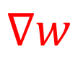
Vanishing and Exploding Gradients
Forward
Backward
output
$$o_{0}$$
$$o_{1}$$
$$o_{2}$$
$$o_{3}$$
$$o_{4}$$
$$\frac{∂h_{1}}{∂h_{0}}$$
$$\frac{∂h_{2}}{∂h_{1}}$$
$$\frac{∂h_{3}}{∂h_{2}}$$
$$\frac{∂o_{3}}{∂h_{3}}$$
…
hidden
$$h_{0}$$
$$h_{1}$$
$$h_{2}$$
$$h_{3}$$
$$h_{4}$$
input
$$x_{0}$$
$$x_{1}$$
$$x_{2}$$
$$x_{3}$$
$$x_{4}$$
$$∇w$$
Notes:
In this course, we will be using PyTorch as our main deep learning framework

Slide 44
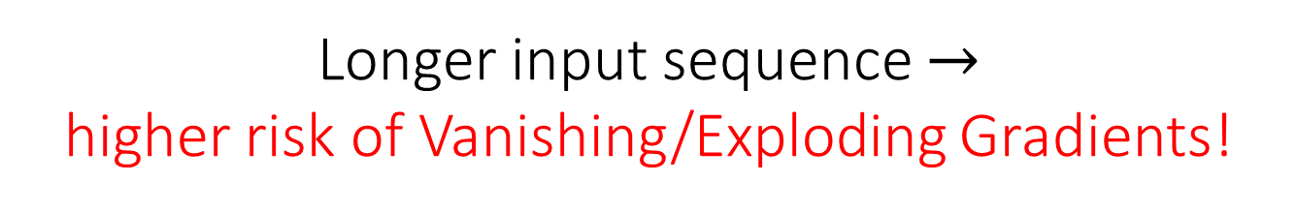
Vanishing and Exploding Gradients
Forward
Backward
output
$$o_{0}$$
$$o_{1}$$
$$o_{2}$$
$$o_{3}$$
$$o_{4}$$
$$\frac{∂h_{1}}{∂h_{0}}$$
$$\frac{∂h_{2}}{∂h_{1}}$$
$$\frac{∂h_{3}}{∂h_{2}}$$
$$\frac{∂o_{3}}{∂h_{3}}$$
…
hidden
$$h_{0}$$
$$h_{1}$$
$$h_{2}$$
$$h_{3}$$
$$h_{4}$$
input
$$x_{0}$$
$$x_{1}$$
$$x_{2}$$
$$x_{3}$$
$$x_{4}$$
Longer input sequence $→$
higher risk of Vanishing/Exploding Gradients!
Notes:
In this course, we will be using PyTorch as our main deep learning framework

Slide 45
Vanishing and Exploding Gradients
Use gated RNN architecture e.g., LSTM, GRU
ReLU activation as nonlinearity
Smaller number of sequence
Smaller learning rate
Notes:
In this course, we will be using PyTorch as our main deep learning framework

Slide 46
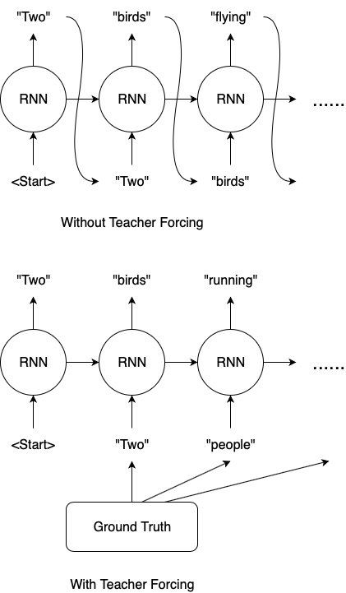
Training RNN with Teacher Forcing
Ground truth
Without Teacher Forcing
With Teacher Forcing
Notes:
In this course, we will be using PyTorch as our main deep learning framework

Slide 47
GATED RNNs Long Short-Term Memory (LSTM) Gated Recurrent Unit (GRU)

Slide 48
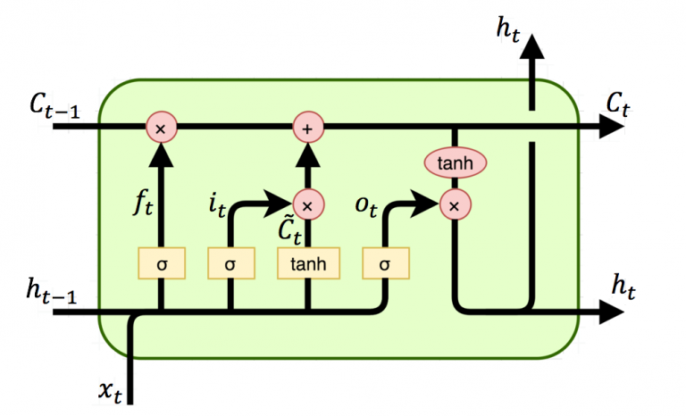
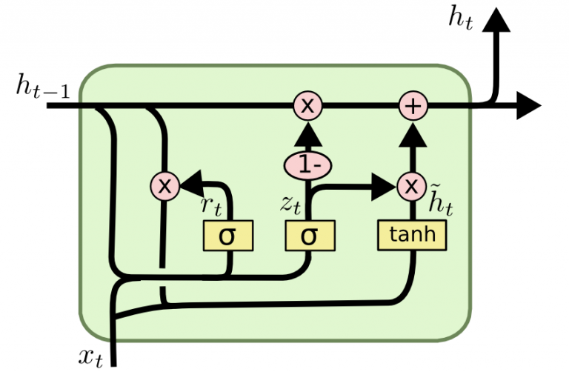
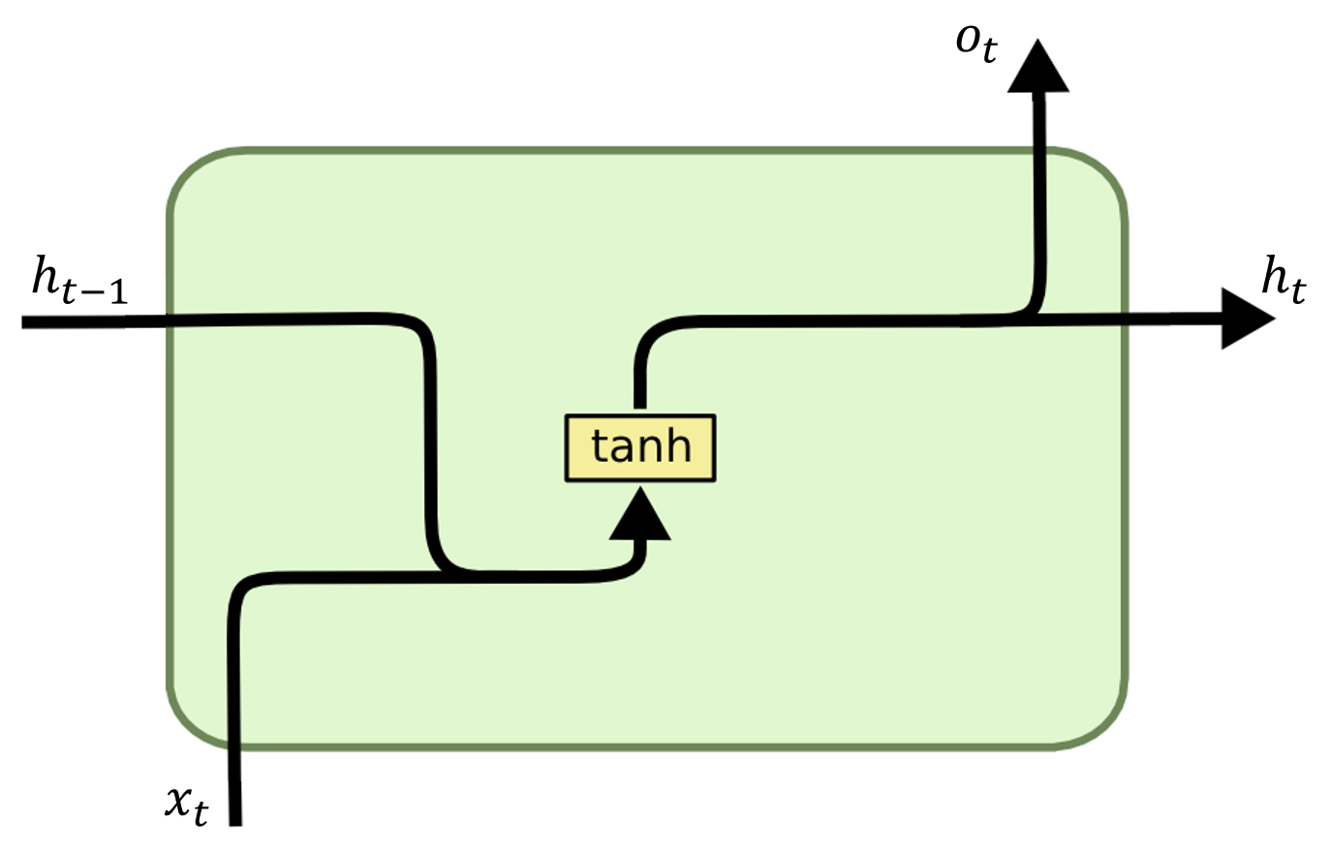

Gated RNNs
Vanilla RNN
LSTM
GRU

Slide 49
Vanilla RNN
Vanilla RNN

Slide 50
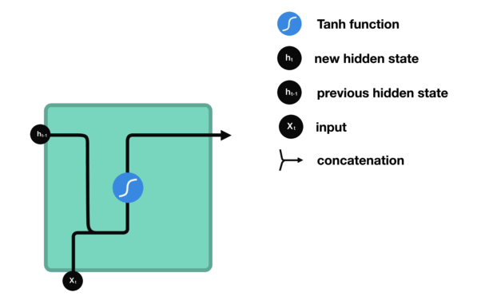
Vanilla RNN

Slide 51
Vanilla RNN

Slide 52
LSTM (Long Short-Term Memory)
LSTM

Slide 53
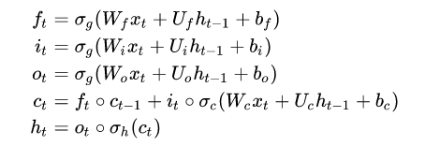
LSTM (Long Short-Term Memory)
LSTM

Slide 54
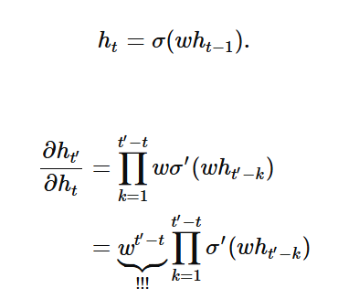
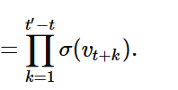
LSTM (Long Short-Term Memory)
Vanilla RNN
LSTM
$$\frac{{∂c}_{t^{′}}}{{∂c}_{t}}$$

Slide 55
LSTM (Long Short-Term Memory)
Vanilla RNN
LSTM
$$\frac{{∂c}_{t^{′}}}{{∂c}_{t}}$$
Gradient decays or grow exponentially if $w ≠1$
No exponential decay or growth term

Slide 56

LSTM: Detailed Architecture
Cell state
Unique to LSTM
Long term memory of the model

Slide 57
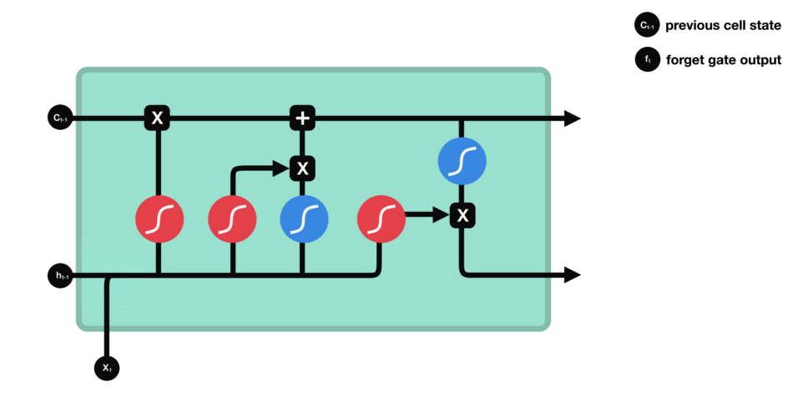

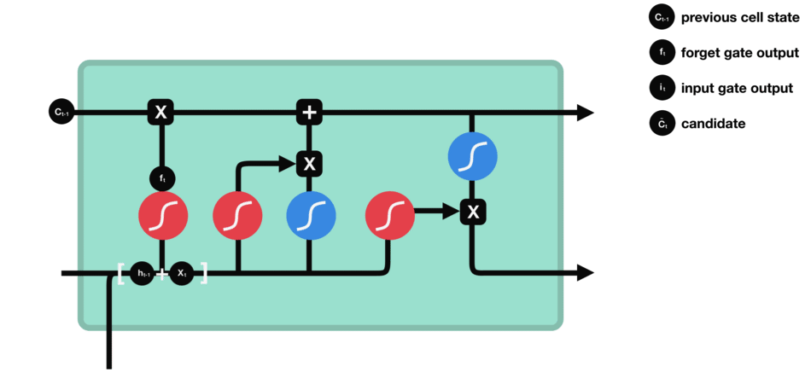

LSTM: Detailed Architecture
Forget gate layer
Input gate layer

Slide 58
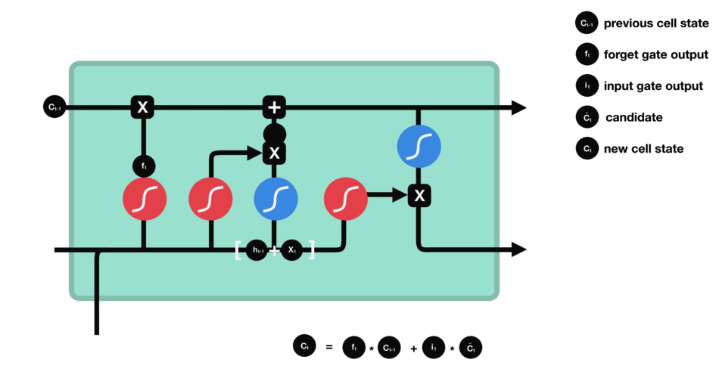



LSTM: Detailed Architecture
Update cell state
Output gate layer

Slide 59
LSTM: Detailed Architecture
Forget gate Decides what is relevant to keep from previous steps
Input gate
Decides what information is relevant to add from the current step
Output Gate
Determines what the next hidden state should be

Slide 60
Gated RNNs
GRU

Slide 61
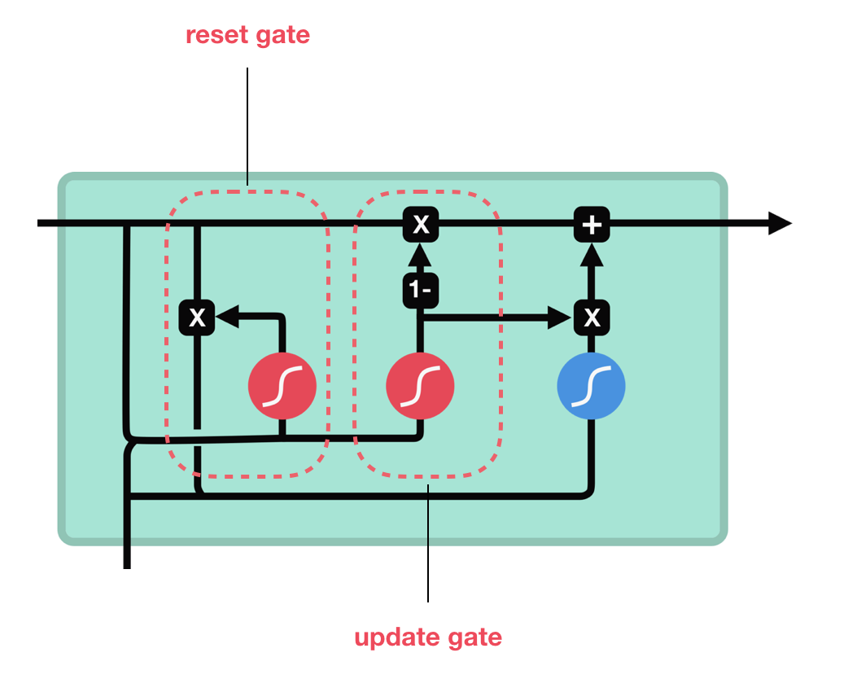

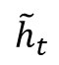
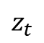
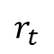
GRU: Detailed Architecture
Sigmoid
Tanh
$$r_{t}$$
$$z_{t}$$
$${\tilde{h}}_{t}$$

Slide 62
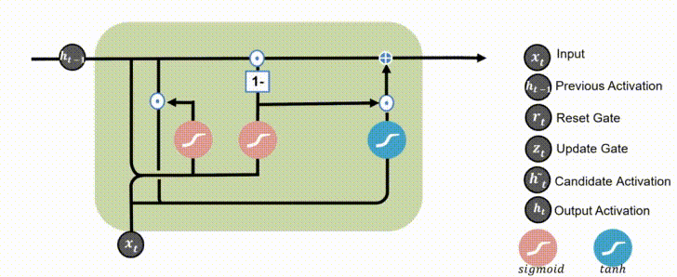
Information Flow in GRU
Reset Gate
Update Gate

Slide 63
GRU: Detailed Architecture
Update gate
How much of the past information needs to be retained
Reset gate How much of the past information to forget

Slide 64
LSTM in PyTorch
torch.nn.LSTM(
input_size
hidden_size
num_layers
)
Parameter description
# of expected features in the input
# of features in the hidden state
# of recurrent layers
Data type
int
int
Default = 1
Official documentation: https://pytorch.org/docs/stable/generated/torch.nn.LSTM.html
Notes:
In this course, we will be using PyTorch as our main deep learning framework

Slide 65
GRU in PyTorch
torch.nn.GRU(
input_size
hidden_size
num_layers
)
Parameter description
# of expected features in the input
# of features in the hidden state
# of recurrent layers
Data type
int
int
Default = 1
Official documentation: https://pytorch.org/docs/stable/generated/torch.nn.GRU.html
Notes:
In this course, we will be using PyTorch as our main deep learning framework

Slide 66
RNN PROBLEM TYPES RNN Configurations RNN Extensions

Slide 67

RNN Configurations
Notes:
In this course, we will be using PyTorch as our main deep learning framework

Slide 68
One to One
Notes:
In this course, we will be using PyTorch as our main deep learning framework

Slide 69
One to One
Identical to Feed Forward Network
Notes:
In this course, we will be using PyTorch as our main deep learning framework

Slide 70
One to Many
Notes:
In this course, we will be using PyTorch as our main deep learning framework

Slide 71
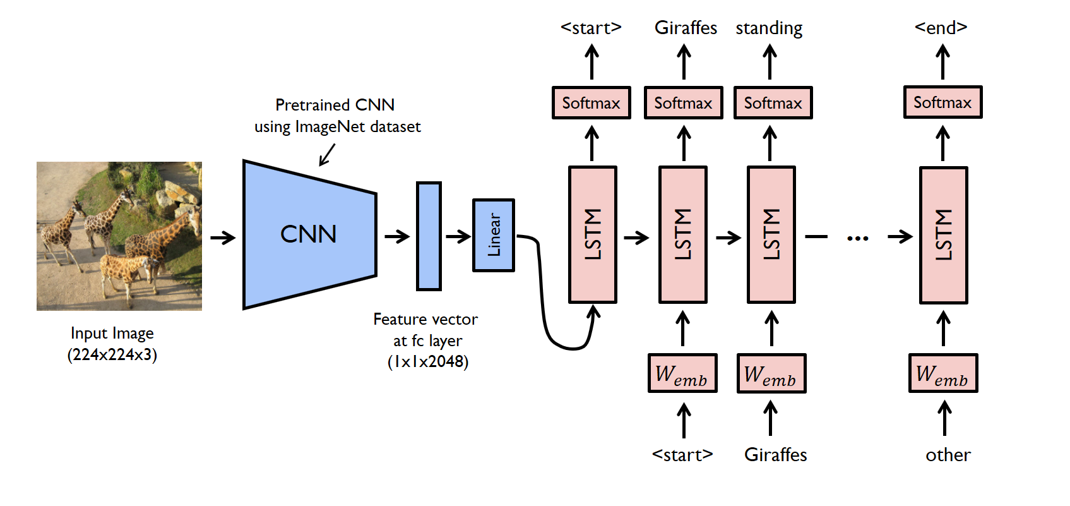



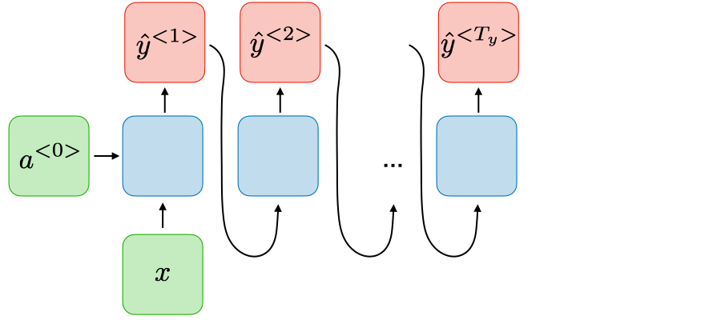
One to Many
Image credit: www.analyticsvidhya.com
Image captioning
Music generation

Slide 72
Many to One
Notes:
In this course, we will be using PyTorch as our main deep learning framework

Slide 73
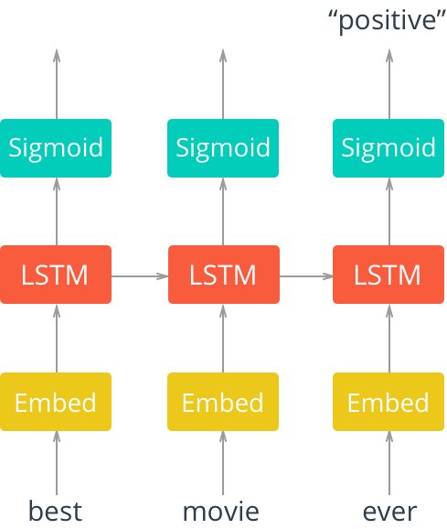
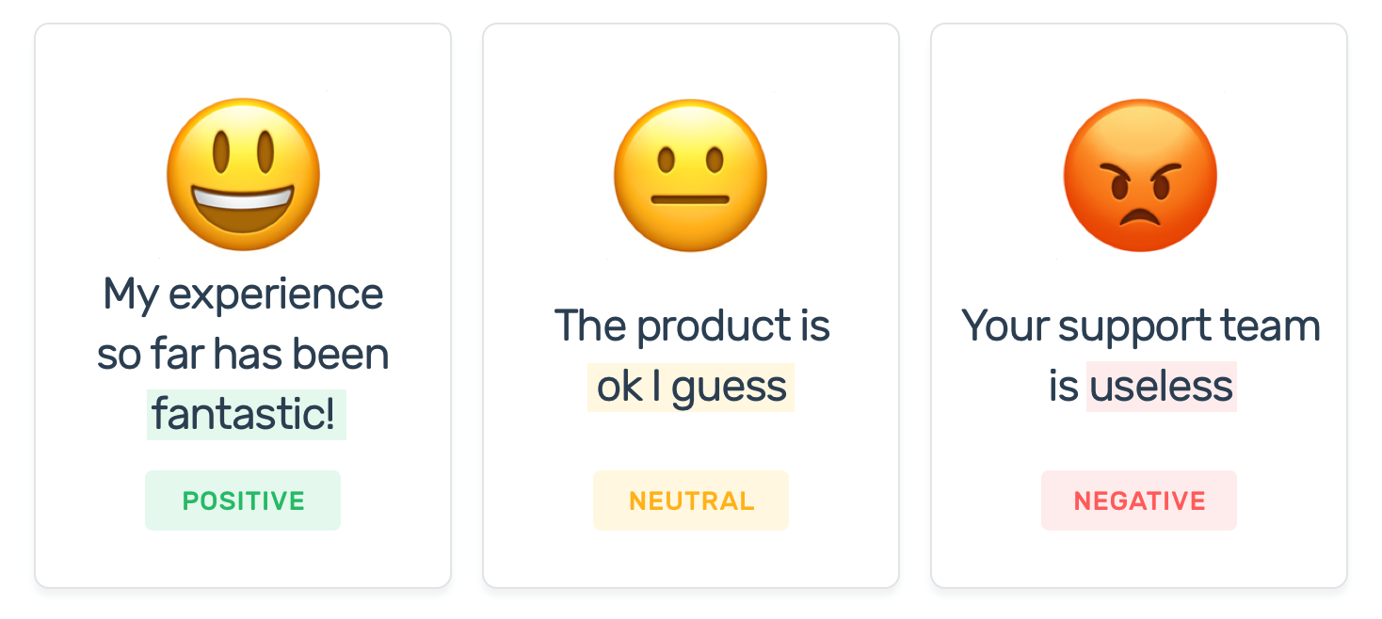
Many to One
Sentiment Analysis

Slide 74
Many to Many
Notes:
In this course, we will be using PyTorch as our main deep learning framework

Slide 75
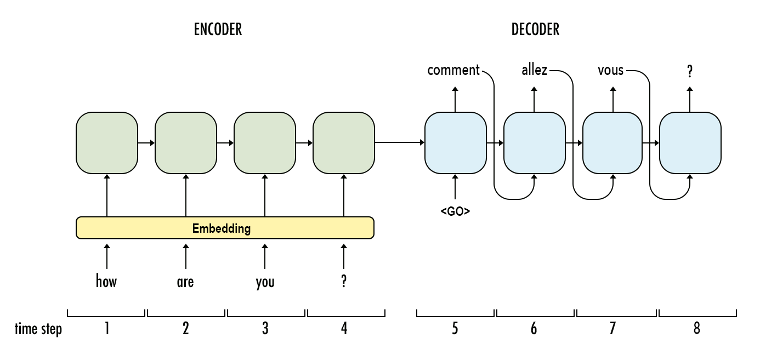
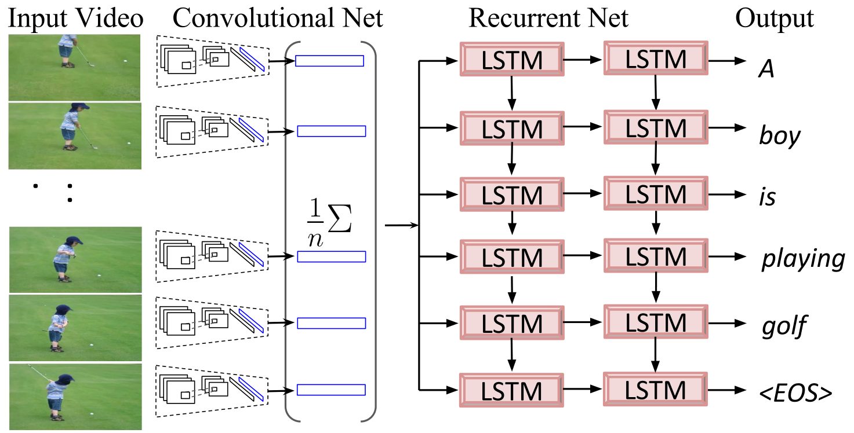
Many to Many
Machine Translation
Video Captioning

Slide 76
RNN IMPLEMENTATION IN PYTORCH Character Level Text Generation using Shakespeare Dataset

Slide 77
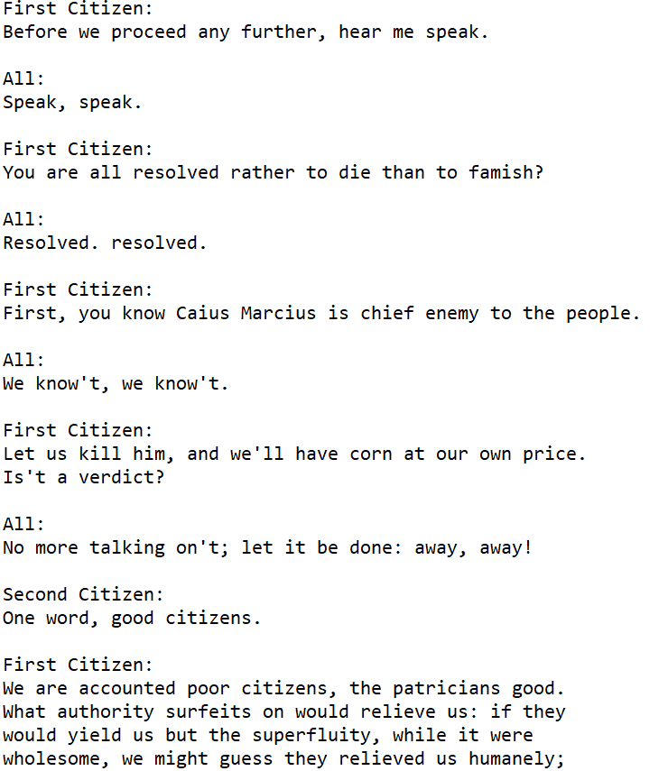
Shakespeare Dataset
Full script of “Tragedy of Coriolanus” in .txt format
3801089 characters (including space)
66 unique characters

Slide 78
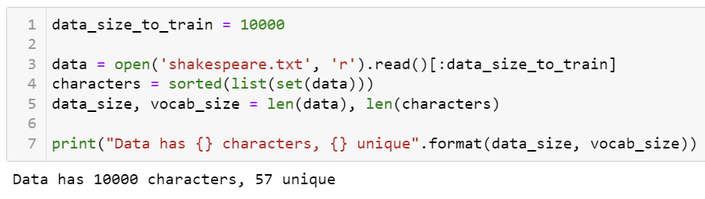

Prepare Data
Define length of training data to be used for training
Load .txt file and sort unique characters using set()
Print # of total and unique characters
Create dictionaries that map each character to numbers and vice versa
Notes:
In this course, we will be using PyTorch as our main deep learning framework

Slide 79

Prepare Data
Convert data into Python list
Map each character in the data to a number
First 10 characters of the data
Notes:
In this course, we will be using PyTorch as our main deep learning framework

Slide 80

Define Model
Define embedding layer
Define RNN cell
Define decoder layer
Input_seq -> embedding layer
Embedding, hidden_state -> RNN cell
RNN output -> decoder layer -> output
Return both output & hidden state
Notes:
In this course, we will be using PyTorch as our main deep learning framework

Slide 81

Select Hyperparameters
Define RNN specifics
# of Embedding = vocab size
Embedding dim = 100
Input_size = 100
Hidden_size = 512
Num_layers = 3
Output_size = vocab size
Define learning rate, epochs, length of training/validation text sequence
Define loss function and optimizer
Notes:
In this course, we will be using PyTorch as our main deep learning framework

Slide 82
Identify Tracked Values
Python list to track training loss
Notes:
In this course, we will be using PyTorch as our main deep learning framework

Slide 83

Train Model
Convert data into torch tensor in vertical orientation (data_length, 1)
For each epoch, randomly select a starting character from first 100 characters
input_seq = character location -> training sequence size
target_seq = character location + 1 -> training sequence size + 1
Retrieve output & hidden state from RNN cell and compute loss
Save training loss
Backpropagation in time & update network
Update the character location
Update the iteration count
Print the averaged training loss throughout an epoch
Notes:
In this course, we will be using PyTorch as our main deep learning framework

Slide 84

Train Model
Initialize character location and hidden state for validation
Pick a random character from the dataset as an initial input to RNN
Generate new output by using the previous RNN output as an input
Convert the output into character number via sampling from the decoder layer output (probability distribution of characters)
Print the actual character from the number
New input_seq is the output character we just generated
Update the character location
Notes:
In this course, we will be using PyTorch as our main deep learning framework

Slide 85
Train Model
output
r
e
w
t
!
r
e
a
t
!
hidden
input
G
r
e
a
t
G
r
e
a
t
Ground truth
During Training
(Teacher Forcing)
During Validation
(RNN output is used as next input)
Notes:
In this course, we will be using PyTorch as our main deep learning framework

Slide 86


Train Model
Generated text sequence after 1 epoch
Generated text sequence after 50 epoch
Notes:
In this course, we will be using PyTorch as our main deep learning framework

Slide 87


Validate & Evaluate Model
Plot the training loss + rolling average training loss after training
Notes:
In this course, we will be using PyTorch as our main deep learning framework

Slide 88
LAB 4 ASSIGNMENT: Create Arthur Conan Doyle AI with RNNs

Slide 89

Sherlock Holmes Dataset
Full collection of Sherlock Holmes series
3011055 total characters (including space)
102 unique characters
Notes:
In this course, we will be using PyTorch as our main deep learning framework

Slide 90

Create Arthur Conan Doyle AI using RNN
h
e
r
l
o
c
k
S
h
e
r
l
o
c
In this exercise, you will implement 1. Vanilla RNN and 2. GRU to generate Sherlock Holmes style sequence of texts.
Prior to training, you can decide the training size you want to use for training. (e.g., first 10k characters, 100k characters, etc)
For both Vanilla RNN and GRU models, design your own RNN architecture with your choice of embedding dimension, hidden state size, number of RNN layers, and training sequence size etc.
After training your RNN, print a validation text sequence for both vanilla RNN and GRU that most closely resembles Sherlock Holmes style in your opinion & plot the training curve to confirm the RNN successfully trained.
Describe which validation text do you like more – Vanilla RNN or GRU? What were the differences of two models during training?
Notes:
Such manipulations of data is easy to do in Python
In this example, we first scale the data such that each feature is normalized according to its mean and standard deviation value.
We then set the test data ratio to be 30% of training data and create 10 validation sets within the training data.
By using the in-built LogisticRegression function in Scikit-learn library, we achieve about 78.79% accuracy in classifying the diabetes

Slide 91
Tips for Training Your RNN
First things to decide
Training data size (# of characters)
Embedding dimension & RNN input
RNN hidden size
(Vanilla RNN) Activation function (ReLU, Tanh)
Decoder output size
Learning rate
Optimizer
Number of training epochs
Training input sequence length
Additional tips
If you get ‘nan’ errors while training -> your training is unstable -> decrease lr or training input sequence length
With ReLU you might be able to process longer sequence
Choose your training data size according to your machine spec
Higher ‘num_layers’ might give you better performance but longer training.
Notes:
Such manipulations of data is easy to do in Python
In this example, we first scale the data such that each feature is normalized according to its mean and standard deviation value.
We then set the test data ratio to be 30% of training data and create 10 validation sets within the training data.
By using the in-built LogisticRegression function in Scikit-learn library, we achieve about 78.79% accuracy in classifying the diabetes

